Slide 1
FIL251 2019
WEEK 2: Utilitarianism

Slide 2
Competing Moral Theories
The good thing to do is to act for the welfare of as many people as possible (Utilitarianism)
The good thing to do is to follow rules (Deontology)
The good thing to do is to develop your character (Virtue Ethics)
The good thing to do is to act in the interests of harmony and relationships (Ubuntu)

Slide 3
NB REMINDERS
Tutorial sign-up sheets are up.
Tutorials are compulsory
Venue HB 1-5
Email policy
Subject Line: [YOUR TUTORS NAME] [YOUR TUTORIAL SLOT]
No questions that can be answered by checking the Study Guide
No content discussed over email – come to consultation
Tuesdays 9.30am – 11.30am
72-Hour Rule
All mark queries must be made within 72 hours of the marks being released
Prepare for Class Tests
Class Rep

Slide 4
Utilitarianism
The cabin-boy thought experiment
Was the killing of the cabin boy morally permissible?
Defense: it was necessary to kill one person to save three
Objection 1: there could be even worse consequences for the majority after the death
This objection accepts the utilitarian assumption that morality consists in weighing costs and benefits, and simply wants a fuller reckoning of the social consequences

Slide 5
Cabin Boy thought experiment
Objection 2: There is a nagging sense that killing and eating a defenseless boy is wrong for reasons that go beyond the calculation of social costs and benefits
This objection rejects the idea that the right thing to do is simply a matter of weighing consequences; it suggests that morality is something more to do with the proper way for human beings to treat each other. Certain duties and rights should command our respect, for reasons independent of the social consequences

Slide 6
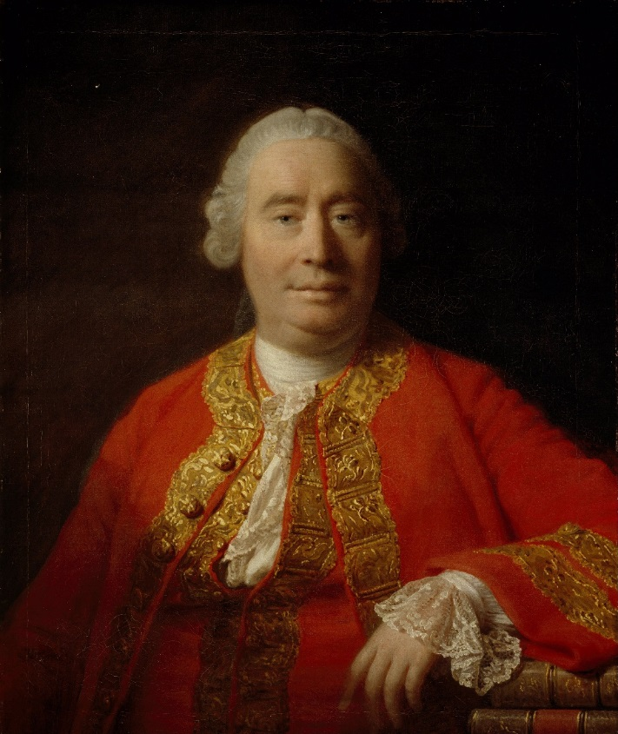
Jeremy bentham (1747-1832)
The right thing to do is to maximize utility
Utility is whatever produces pleasure or happiness, and whatever prevents pain or suffering
The Greatest Happiness Principle…
Consequentialist ethics

Slide 7
Utilitarianism Objections
Two objections:
1. It fails to respect individual rights
The city of happiness
Throwing Christians to lions
2. You can’t measure everything on the same scale of value
Especially common in the business world
Exploding gas tanks
Pain for pay – what would you pay?
St. Anne’s girls – paying money to sleep over

Slide 8
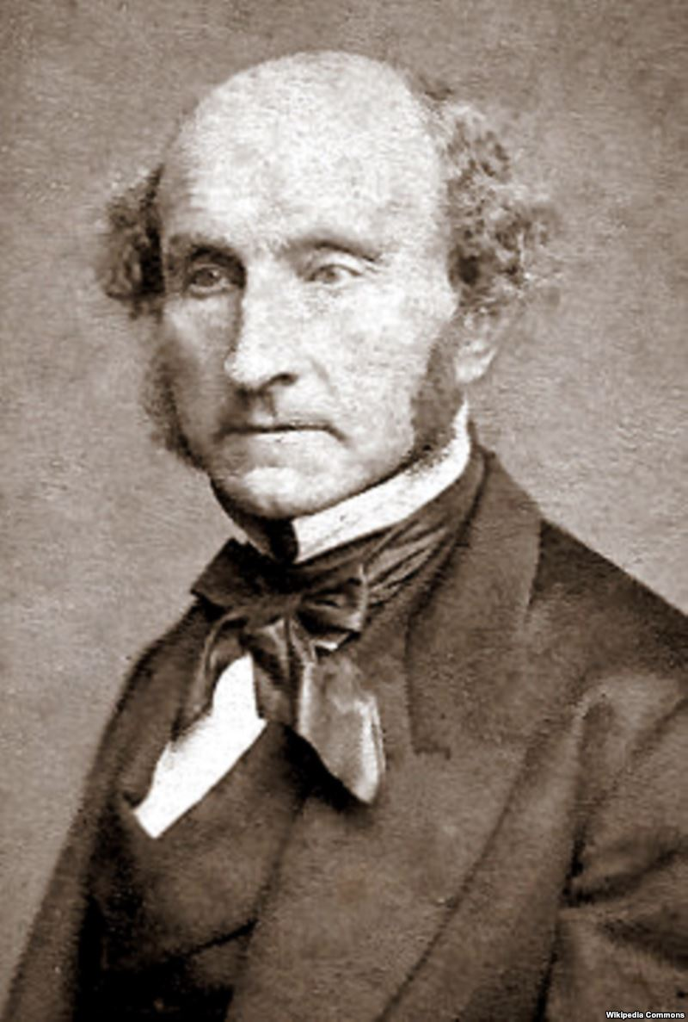
John Stuart mill (1806-1873)
Persons = accountable only for actions that affect others
Independence = absolute, provided I do not harm others.
Person = sovereign right over his body & mind

Slide 9
Mill: Utilitarianism and Individual Rights
Fix Bentham
Obection 1 to Bentham’s utilitarianism:
1. It fails to respect individual rights
Mill thinks we should maximize utility, not on a case-by-case basis, but in the long run. And over time, respecting individual liberty will lead to the greatest human happiness.
Independent thinking and decision-making leads to social progress
How?
Improvement of collective ideas, dissent may be right, prevents dogma and stagnation of human thinking

Slide 10
2 Objections to Mill’s attempt to reconcile utilitarianism with individual rights
Objection 1 to Mill’s attempt to reconcile utilitarianism with individual rights:
If utilitarianism is paramount, so human rights would only be important if they please the majority, so may still be violated
Objection 2 to Mill’s attempt to reconcile utilitarianism with individual rights:
Mill basing individual rights on utilitarian considerations misses the sense in which violating someone’s rights inflicts wrong on the individual, whatever its effect on the general welfare.

Slide 11
Higher and Lower Pleasures
Obection 1 to Bentham’s utilitarianism: You can’t measure everything on the same scale of value
Mill’s answer: higher and lower pleasures
What makes one pleasure higher than another?
Higher if those who experience both choose one over the other (utilitarian intuition)

Slide 12
Higher and Lower Pleasures
What makes one pleasure higher than another?
Higher if they engage mental faculties unique to humans (it’s about dignity: don’t act like an animal)
humans different from animals: able to engage mental faculties
Better to be a human dissatisfied than a pig satisfied
Shakespeare vs Simpsons vs WWE
Mill is confused: higher because more people refer them? Or higher because they engage mental faculties? Are they higher because most people prefer them or because humans have dignity?

Slide 13
Act vs Rule utilitarianism
ACT UTILITARIANISM (Bentham)
Will this action result in the greatest possible utility?
RULE UTILITARIANISM (Mill)
Does this action comply with a set of rules that will guarantee the greatest possible utility (in the long run)?

Slide 14
first Class Test Wednesday 24 july
Give two branches of philosophy (2)
What is the name of the thought experiment we discussed in class last week where we dealt with the dilemma of choosing to save 1 person or 5? (2)
What is the name of the type of government that is opposed to the biased government? (1)

Slide 15
second Class Test Wednesday 24 July
When we say that something is corrupt, we mean that it is [blank]. (1)
What is in tension with self-interest with regards to corruption? (2)
When someone does not act according to their principles, we say that that person lacks [blank]. (1)
Give one dimension of ethical thinking. (1)

